Slide 1
Day Surgery Experiences from the UK
Masterclass in Ambulatory Surgery
Ian Jackson
Doug McWhinnie
April 3 2025

Slide 2
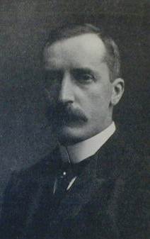
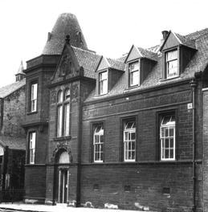
Father of modern Day Surgery
1899-1908 reported on 8988 ops
performed at the Sick Children’s Hospital & Dispensary, Glasgow
BMJ 2:753, 1909
James H. Nicoll (1864–1921)

Slide 3
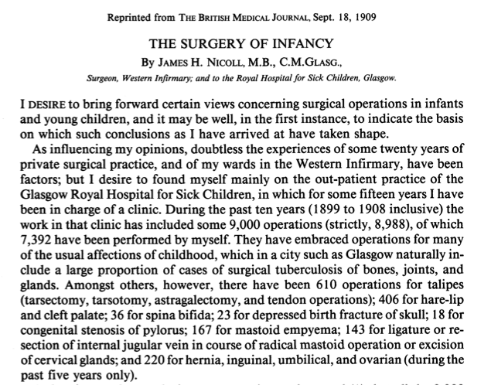
Notes:
3

Slide 4
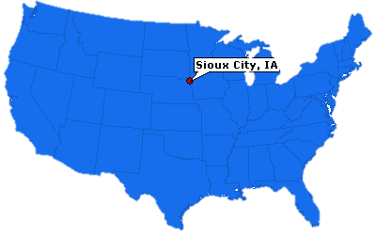
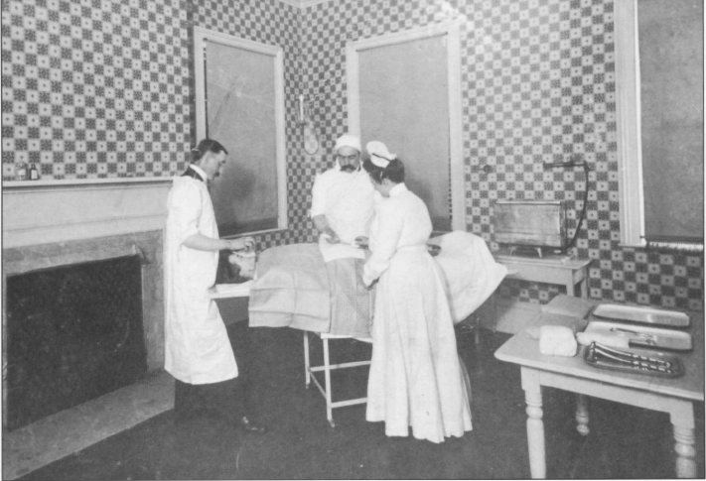
1919: The Down-Town Anesthesia Clinic, Sioux City, USA
Ralph Waters
(1883–1979)
Notes:
4

Slide 5
Little Progress – British Medical Journal Editorial 1948
“Any surgeon who allows a patient to leave hospital within 14 days of an abdominal operation (this would include hernia repair) would be in a difficult position should complications occur’’.

Slide 6
First Hospital-based Day Surgery Units in USA
1951: Grand Rapids, Michigan
1952: Los Angeles
Fiscal benefits drove the progress of ambulatory surgery
in the USA and Australia, in 50s, 60s and 70s

Slide 7
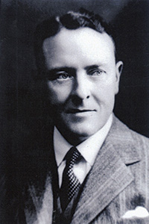
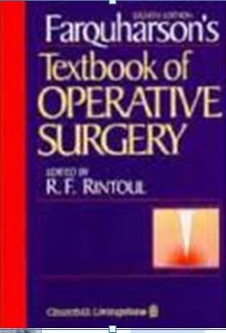
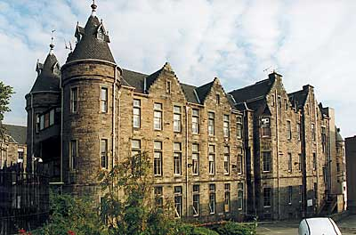
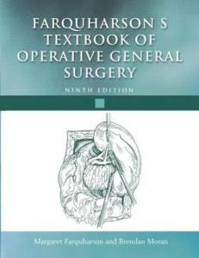
1955 Day Case Inguinal Herniae
458 Consecutive Day Case Inguinal Hernia Repairs
Eric L Farquharson
Farquharson EL, Lancet 1955; ii:517-9

Slide 8
Progress in the 1960s, and 1970s
Hospital-Based Ambulatory Units
1962 Los Angeles, University of California
1966 George Washington University Hospital, Washington
1968 Providence, Rhode Island
Freestanding Ambulatory Units
1969 Surgicenter, Phoenix, Arizona

Slide 9
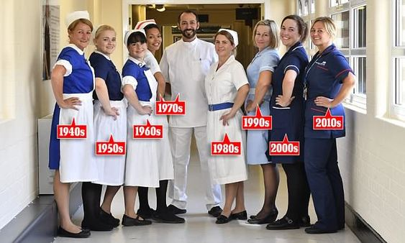
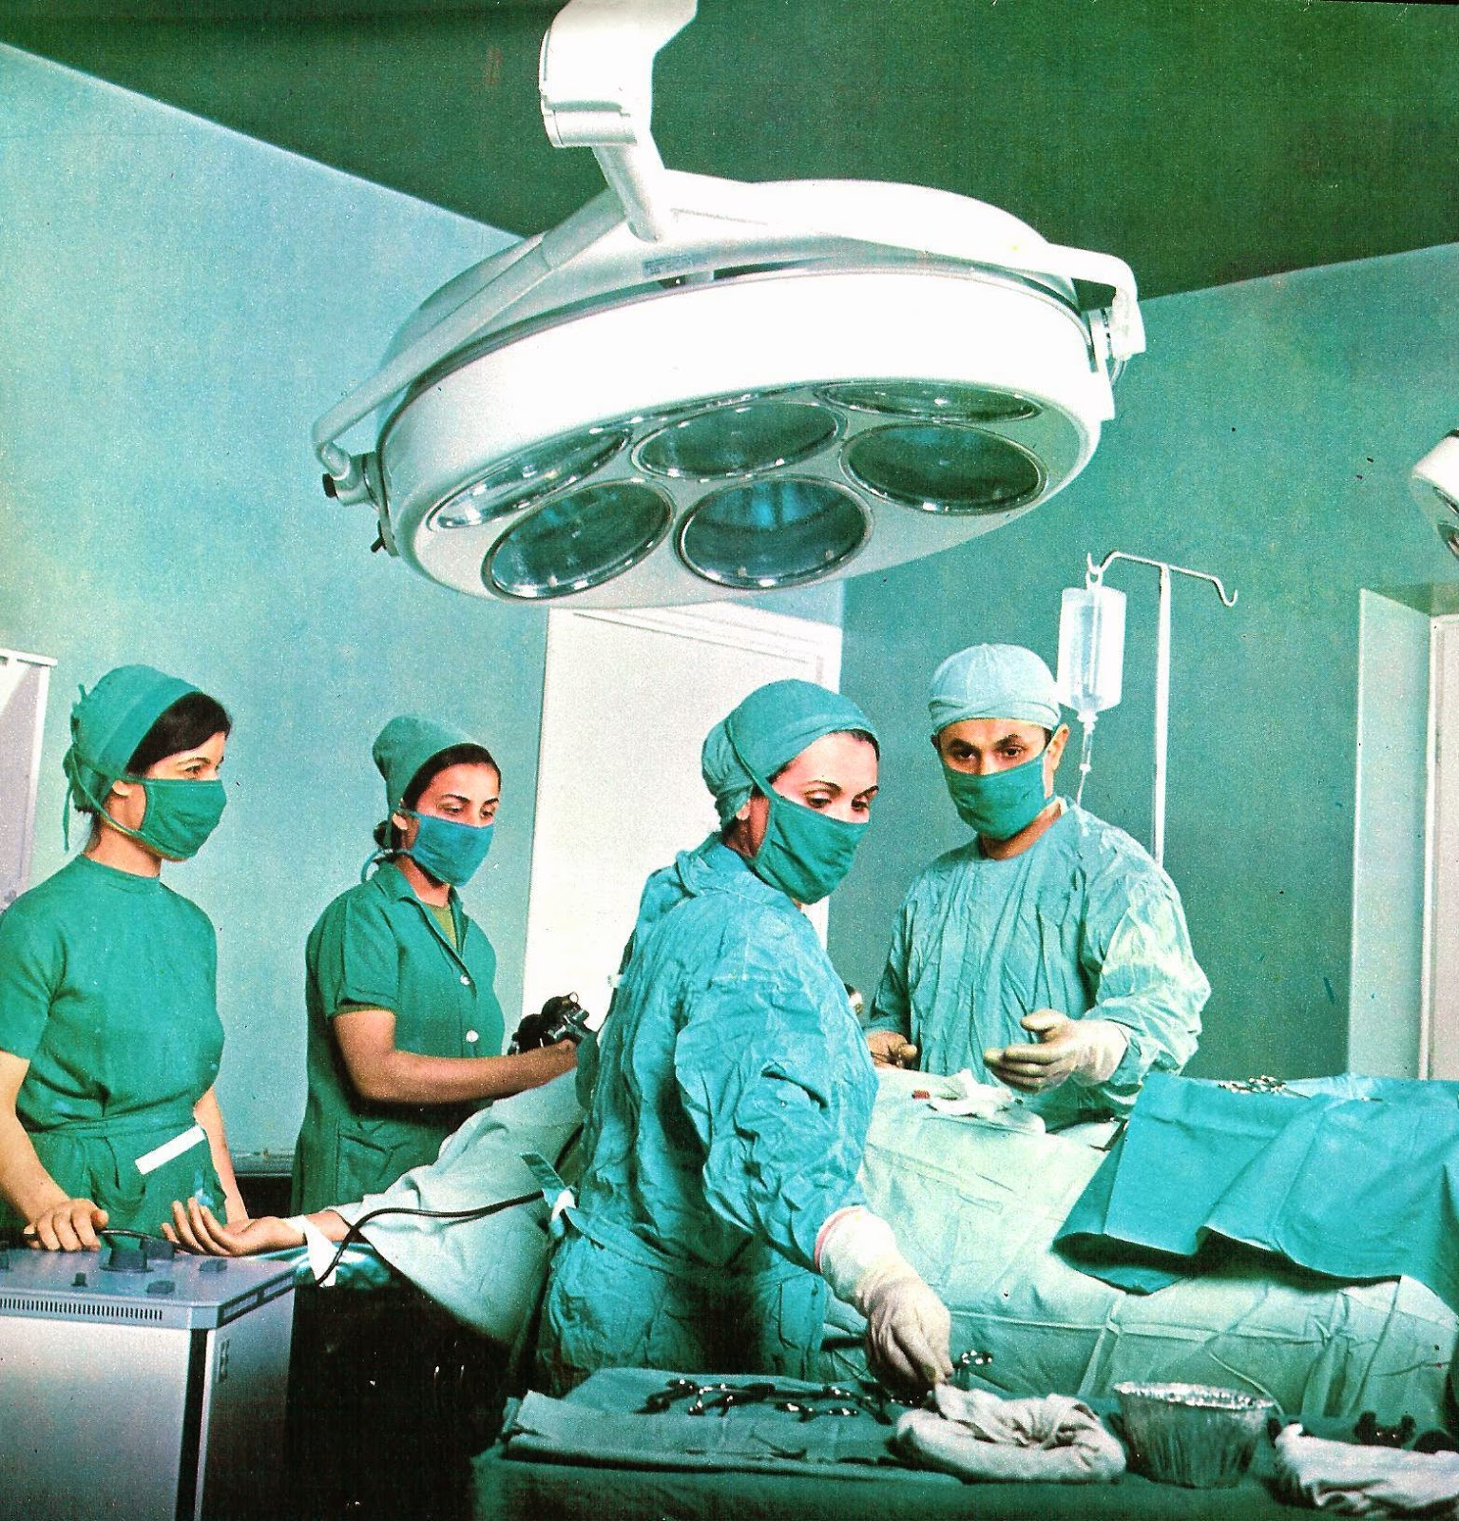
Early UK Day Surgery
The 1960s, 1970s and 1980s
Pioneering enthusiasts
Local developments
No coordinated approach
Clinical establishment apathetic

Slide 10
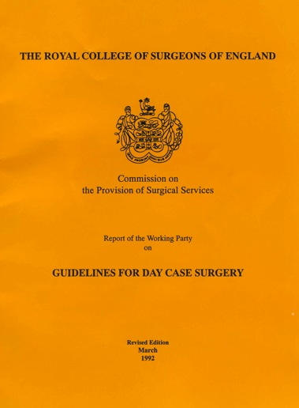
Royal College of Surgeons
Published 1985 (revised 1992)
50% elective Surgery as Day Case achievable

Slide 11
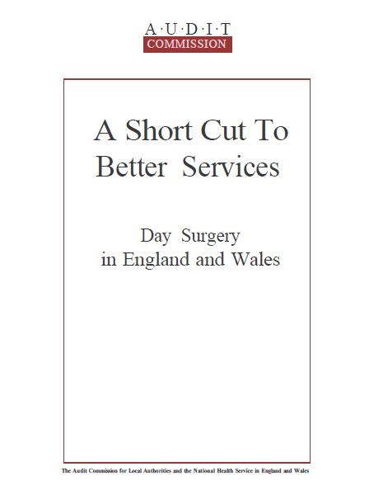
Timeline
1989 Management and Utilisation of Operating Departments NHSME VFM Unit
1990 A Short Cut to Better Services Audit Commission
1990 Basket of Procedures Audit Commission
1991 Day Surgery – Making it Happen NHSME VFM Unit
1991 Measuring Quality: The Patient’s View of Day Surgery Audit Commission
1993 Day Surgery – Report by the Day Surgery Taskforce NHS Executive
Notes:
11

Slide 12
Formation of the British Association of Day Surgery 1989
Paul Jarrett Kingston
Tom Ogg Cambridge
Jean Millar Oxford
Tony Davenport Northwick Park
Peter Simpson Liverpool
Sarah Penn Barnet
Chris Ward Charing Cross

Slide 13
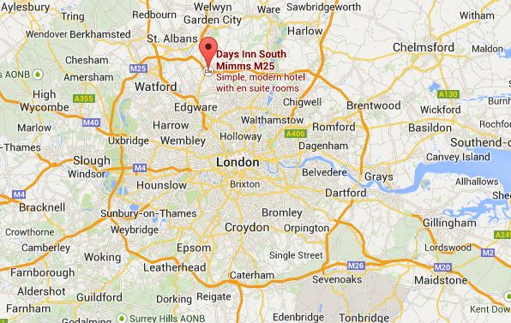
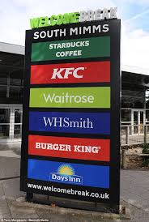
South Mimms Services

Slide 14
Audit Commission Basket of Procedures 1990
Inguinal Hernia Repair
Excision Breast Lump
Anal Fissure Excision
Varicose Vein Surgery
Cystoscopy
Circumcision
Excision of Dupuytren’s Contracture
Carpal Tunnel Decompression
Arthroscopy
Excision of Ganglion
Cataract Extraction
Squint Correction
Myringotomy
Sub Mucus Resection
Reduction of Nasal Fractures
Bat Ear Correction
D&C
Laparoscopy+/- Sterilisation
Termination of Pregnancy
Orchidopexy

Slide 15
Notes:
15

Slide 16
Audit Commission Basket of Procedures 2001
Cataract Extraction
Excision Breast Lump
Carpal Tunnel Decompression
Bat Ears
R/O Metalwork
Bunion Operations
Laparoscopy
Tonsillectomy
TURBT
Squint Correction
Orchidopexy
Anal Fissure
D&C / Hysteroscopy
Nasal Fractures
Myringotomy
Laparoscopic Cholecystectomy
Excision of Ganglion
Hernia Repair
Varicose Veins
Dupuytren’s Contracture
Haemorrhoidectomy
Circumcision
Arthroscopy
SMR
Termination of pregnancy
Notes:
16

Slide 17
Government Initiatives

Slide 18
75% Of Elective Surgery To Be Performed On A Day Case Basis
1967 - 40% Ministry of Health
1985 - 50% Royal College of Surgeons
1994 - 60% NHS Executive
2001 - 75% NHS Plan
White Paper, 2000
Notes:
18

Slide 19
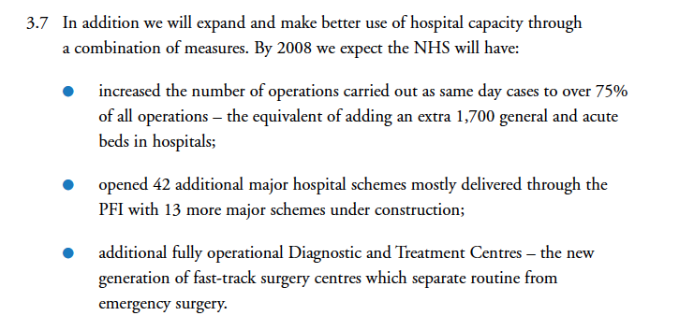
Alan Milburn NHS Plan (2002)
Notes:
19

Slide 20
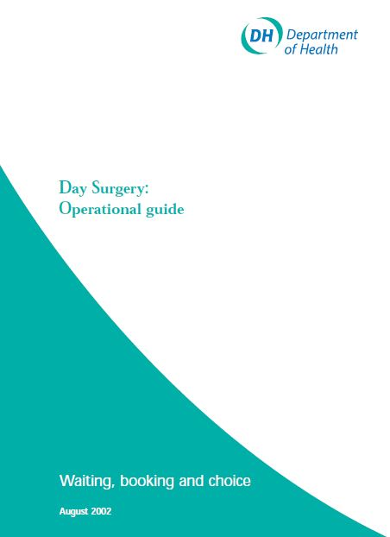
Day Surgery Definition
Day surgery is the admission of selected patients to hospital for a planned surgical procedure, returning home on the same day.
Day Surgery:Operational Guide. DoH, London,2002

Slide 21
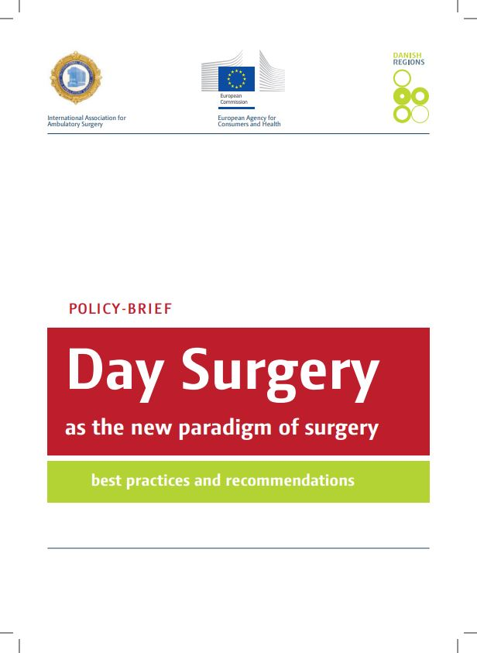
Day Surgery Definition
‘A surgical day case is a patient who is admitted for an operation on a planned non-resident basis and who nonetheless requires facilities for recovery. The whole procedure should not require an overnight stay in a hospital bed’.
Day Surgery as the new paradigm of surgery / Danish Regions 2013 / 22

Slide 22
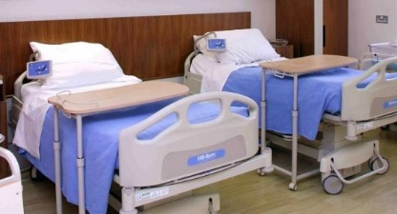
Traditional Model For Elective Admissions
Day 1
Day 2
Day 3+
Admission
Treatment
Discharge
Minimum 2-Night Stay

Slide 23
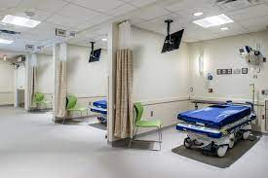
Day Surgery Model For Elective Admissions
Day 1
Preassessment
Admission
Treatment
Discharge
Maximum 12 Hour Stay

Slide 24
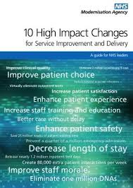
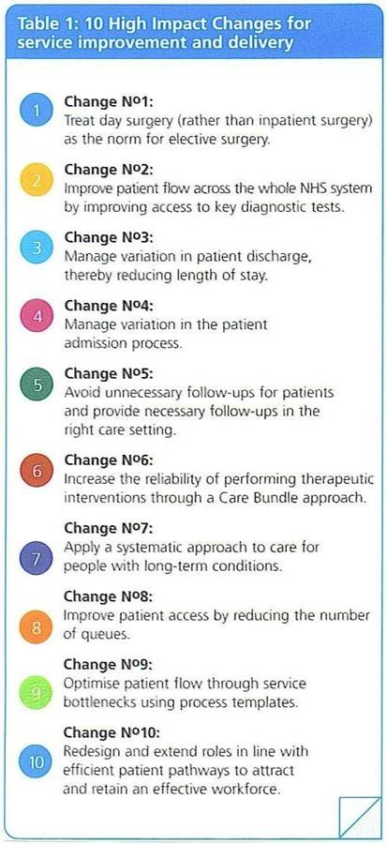
Modernisation Agency 2004
Treat day surgery (rather than in-patient surgery) as the norm for elective surgery
“Default to Day Surgery’’

Slide 25
Default to Ambulatory Surgery Philosophy
Do not ask whether this patient CAN be a day case
Ask whether there is any reason this patient CANNOT be a day case
Yes
Maybe
No
Overnight
Stay
Optimise for Day Surgery
Day Surgery

Slide 26
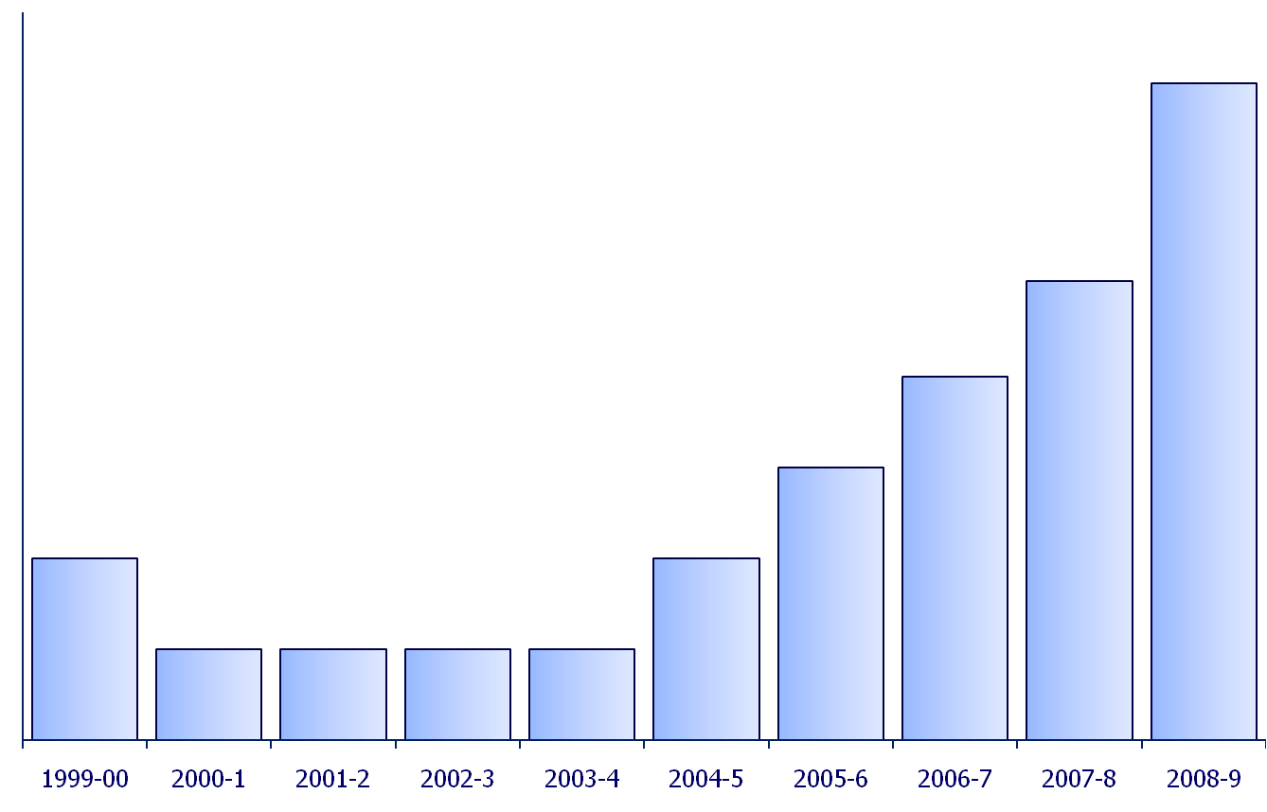
Progress in Day Surgery UK 1999-2009
75%
50%
25%

Slide 27
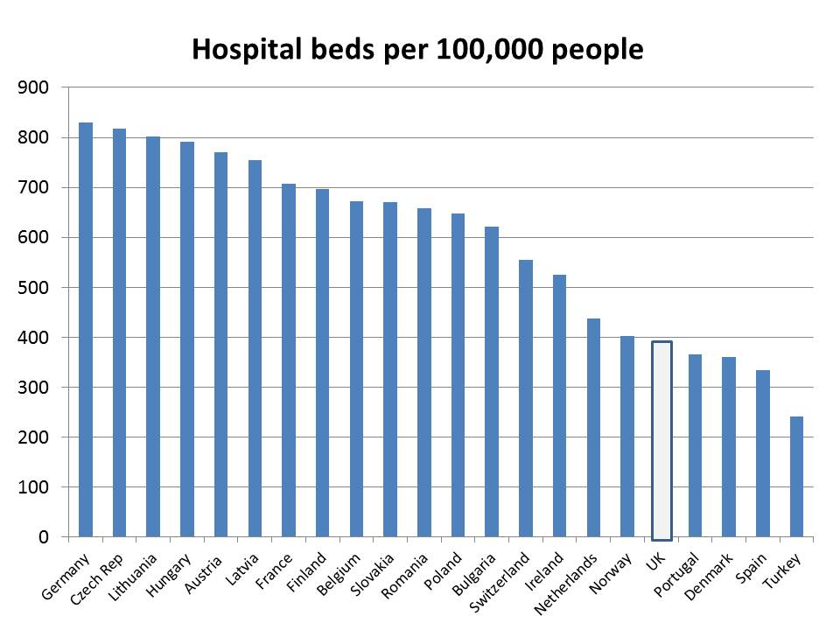

Slide 28
IAN

Slide 29
British Association of Day Surgery - rebrand

Slide 30
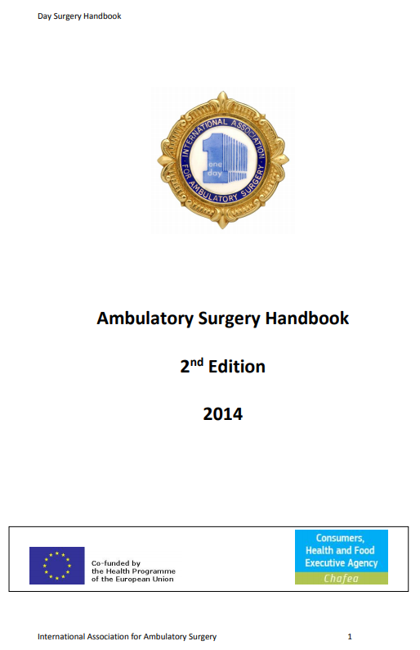
Procedures Suitable for Ambulatory Surgery
No Definitive List
Lemos P, Jarrett P, Philip B
IAAS, London; 2006
https://theiaas.net/textbook-day-surgery-development-practice
Jackson IB, 2014;
https://theiaas.net/day-surgery-handbook

Slide 31
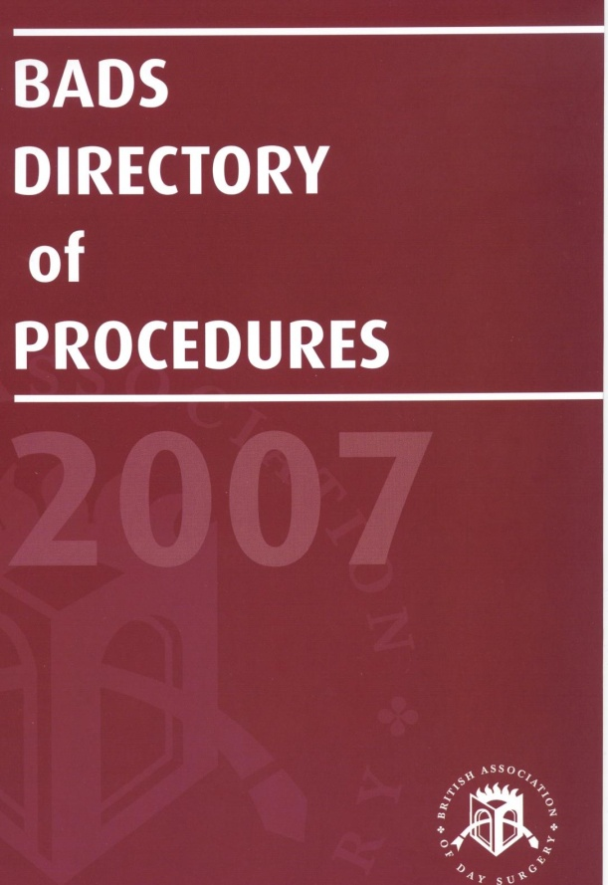
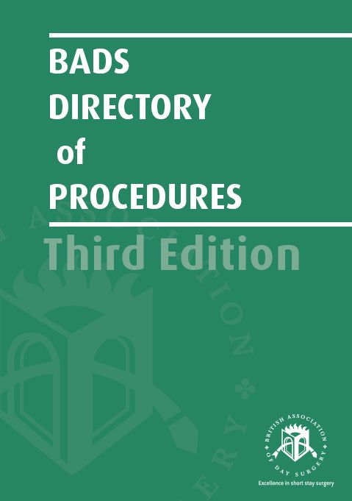
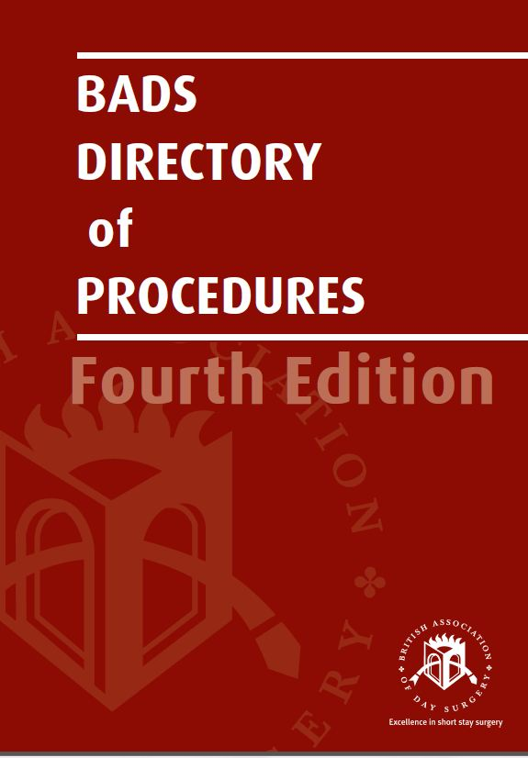
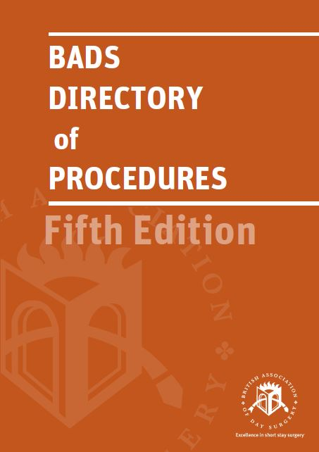
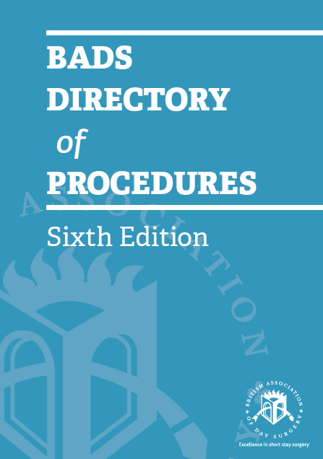
www.bads.co.uk

Slide 32
Surgical Sub-Specialties
Breast Surgery
ENT
General Surgery
Gynaecology
Head and Neck Surgery
Ophthalmology
Orthopaedics
Paediatric Surgery
Urology
Vascular Surgery
Medical Procedures
Emergency Surgery
12 Subspecialties
>200 Procedures

Slide 33
British Association of Day Surgery Directory of Procedures
Literature review
National and International Day Surgery Data
Networking
Specialist organisations
Aspirational percentages for
Procedure Room
Zero night stay
(Day Surgery 12 hours)
One night stay
(23 hour surgery)
Two night stay

Slide 34
Target Percentages for Length of Stay Management

Slide 35
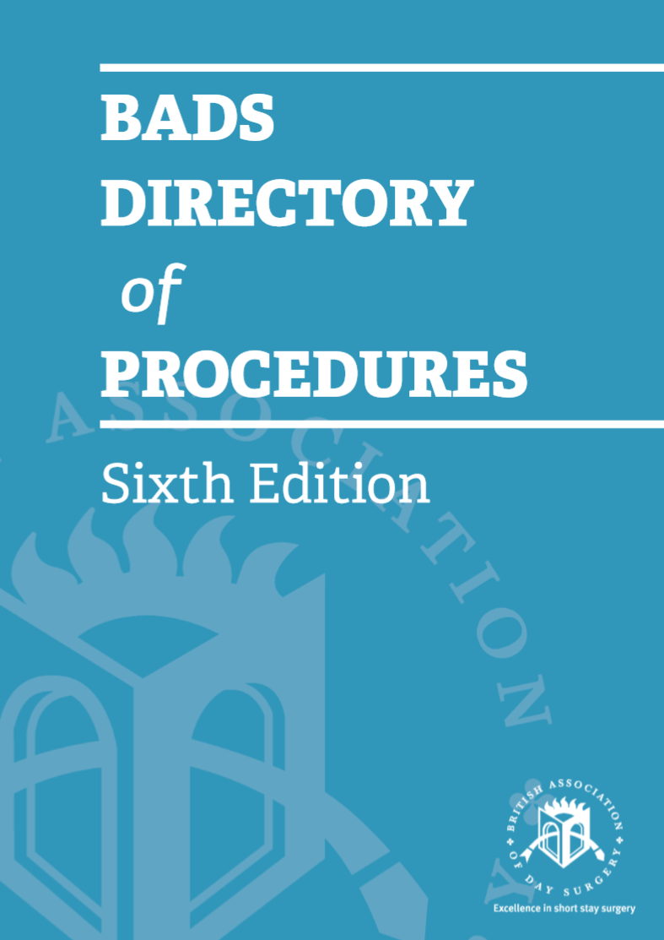
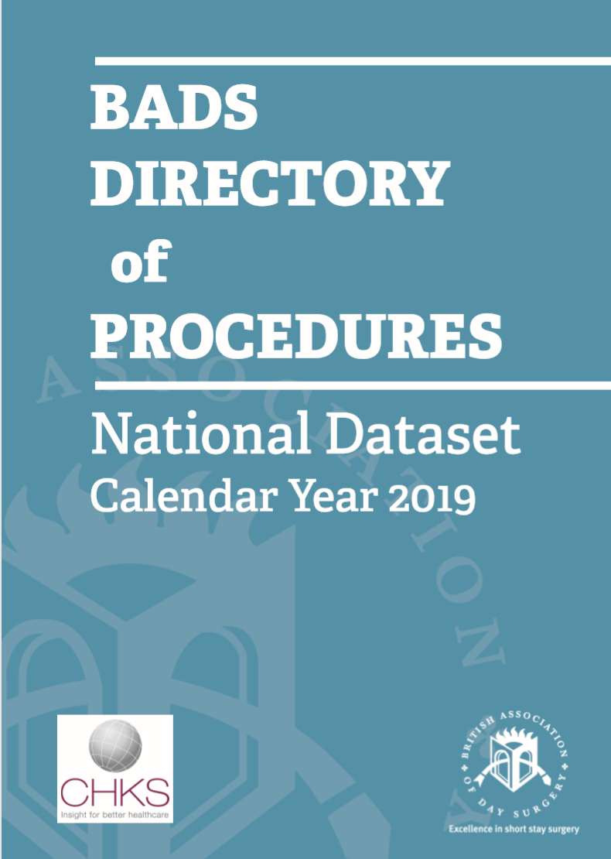
Now also have National Dataset

Slide 36
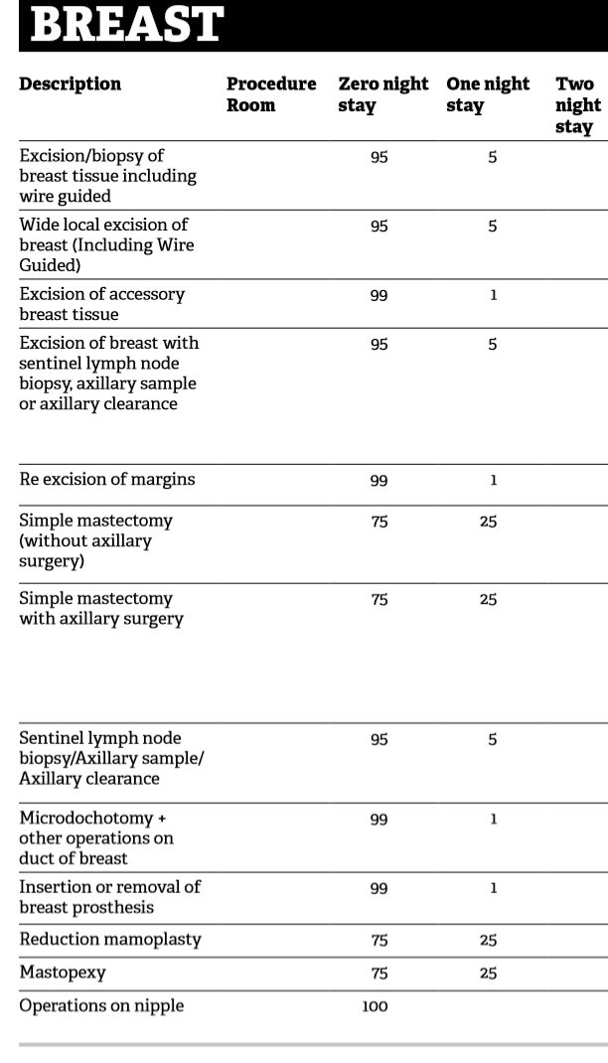

Slide 37
Next phase – drive to improve performance
Financial drive
Feedback of performance

Slide 38
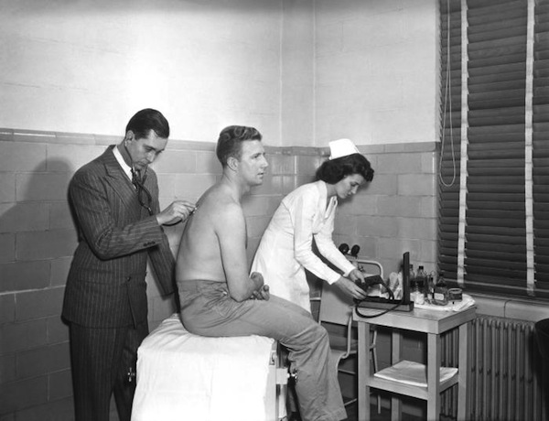
UK National Health Service 1948
‘Free healthcare for all from cradle to grave’

Slide 39
Finance
Central Government Taxation
Regional Funding Allocation based on Population
Community Services
General Practitioners
Hospital Care

Slide 40
Hospital Funding
Based on catchment population
Number of procedures and case mix irrelevant to funding
Money received by hospitals fixed regardless of number patients treated

Slide 41
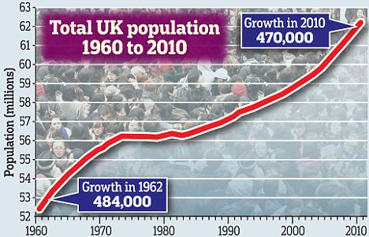
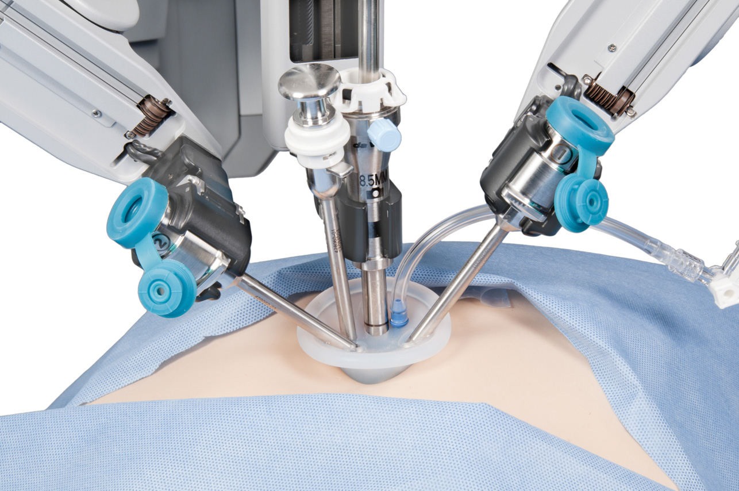
Funding becomes more complex
Increasing population
Increasing rate of demand
Introduction of Technology
Aging population
Population change per area
Increase in ambulatory surgery

Slide 42
NHS Funding Models
Until 2005 the money a hospital received was fixed, regardless of the number of patients it treated (block contract)
From 2006 Under Payment by Results, payments are made based on activity delivered (PbR)
Notes:
42

Slide 43
2006
Payment by Results (PbR) introduced throughout NHS in England
Payment for health activity, not per head of population
‘Money will follow patients’
Prime Minister Gordon Brown

Slide 44
Finance
Central Government Taxation
Regional Funding Allocation based on Activity
Community Services
General Practitioners
Hospital Care

Slide 45
Problem with PbR
Day Surgery
Money follows patients
Tariff for overnight stay > day surgery
Therefore
Why bother with day surgery ?

Slide 46
Problem with PbR
Government wished to promote Day Surgery to reduce health care costs
Laparoscopic Cholecystectomy identified as offering the greatest cost savings by converting to Day Surgery
HOW TO ACHIEVE THIS ?

Slide 47
British Association of Day Surgery Proposal
Equal payment for procedures performed as day cases or overnight stay
Incentivise good practice such as day surgery
Removes financial incentive to keep patient overnight
Financially rewards hospitals for Day Surgery procedures

Slide 48
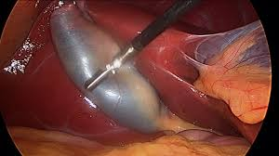
Best Practice Tariff
Introduced initially for Laparoscopic Cholecystectomy
2009:
Day case: €1775
In-patient: €1775
For 2010-11:
Day case: €2202
In-patient: €1779

Slide 49
Impact of Best Practice Tariff
Howard, et al. J One-day Surgery 21: 4, 2011
Best practice tariff
80
% Lap Chole as Day Case
70
60
50
40
30
20
10
0
2007
2008
2009
2010

Slide 50
Best Practice Tariffs 2015
Breast Surgery:
Mastectomy, Sentinel Node Biopsy, Axillary Clearance
ENT:
Tonsillectomy, Septoplasty, Mastoid Ops
Orthopaedics:
Dupuytren’s, Subacromial decompression, Bunion ops
Gynaecology:
Female incontinence surgery, Outpatient Hysteroscopy/Sterilisation
Urology:
Resection of Prostate, Outpatient Cystoscopy
General Surgery:
Laparoscopic Cholecystectomy, Hernia Repair

Slide 51
Payment..
 | Daycase (£) | Inpatient (£) | Diff (%)
Laparoscopic Cholecystectomy | 1909 | 1726 | 10.6%
Inguinal/Umbilical/Femoral Hernia Repair | 1363 | 1228 | 11.0%
Ops for urinary incontinence | 1181 | 1067 | 10.7%
Tonsillectomy (adult) | 1094 | 988 | 11.0%
Mastectomy | 2123 | 1928 | 10.2%
TUR (Prostate) | 2127 | 1931 | 10.2%
Septoplasty | 1237 | 1119 | 10.5%
Tympanoplasty/Mastoid Ops | 1842 | 1664 | 10.7%
Dupuytren’s Repair | 1715 | 1547 | 10.9%

Slide 52
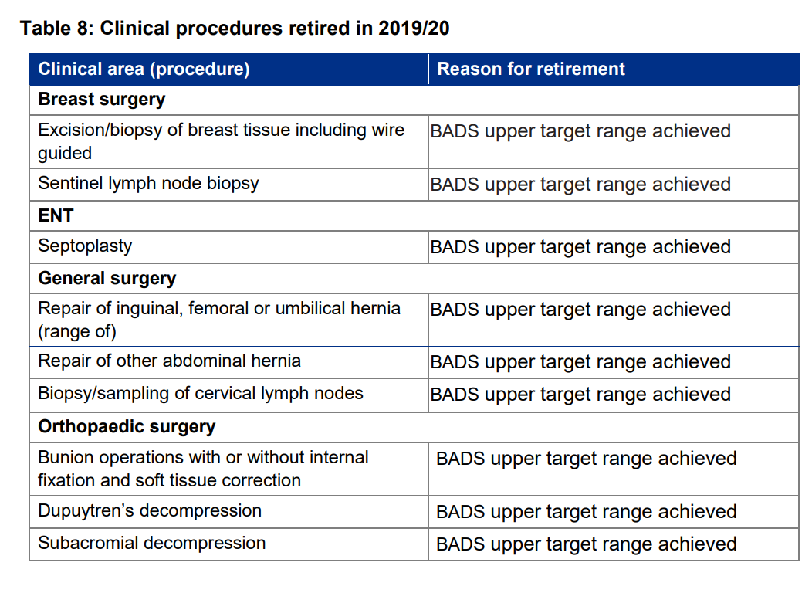
Success

Slide 53
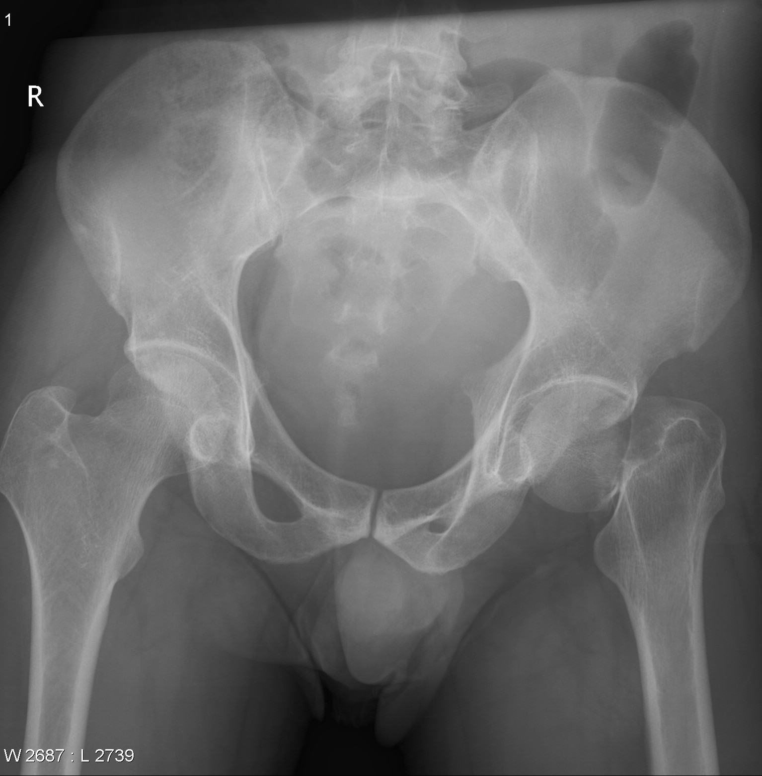
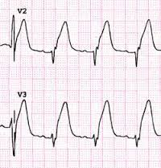
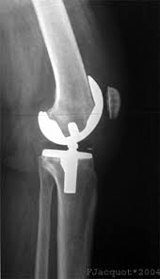
Best Practice Tariffs
Best practice tariff now applied to :
Many Surgical procedures
Fragility Hip Pathway
Minor Medical procedures
Myocardial Infarct
COPD
Primary Hip and Knee replacement

Slide 54
Finance
Central Government Taxation
Regional Funding Allocation based on Activity and Outcome
Community Services
General Practitioners
Hospital Care

Slide 55
Feedback to hospitals

Slide 56
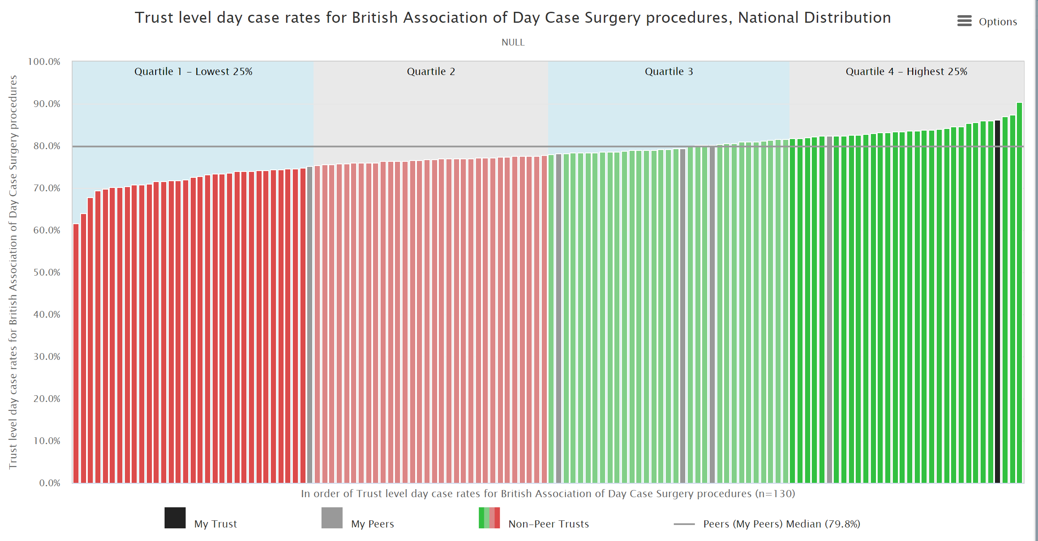

Slide 57
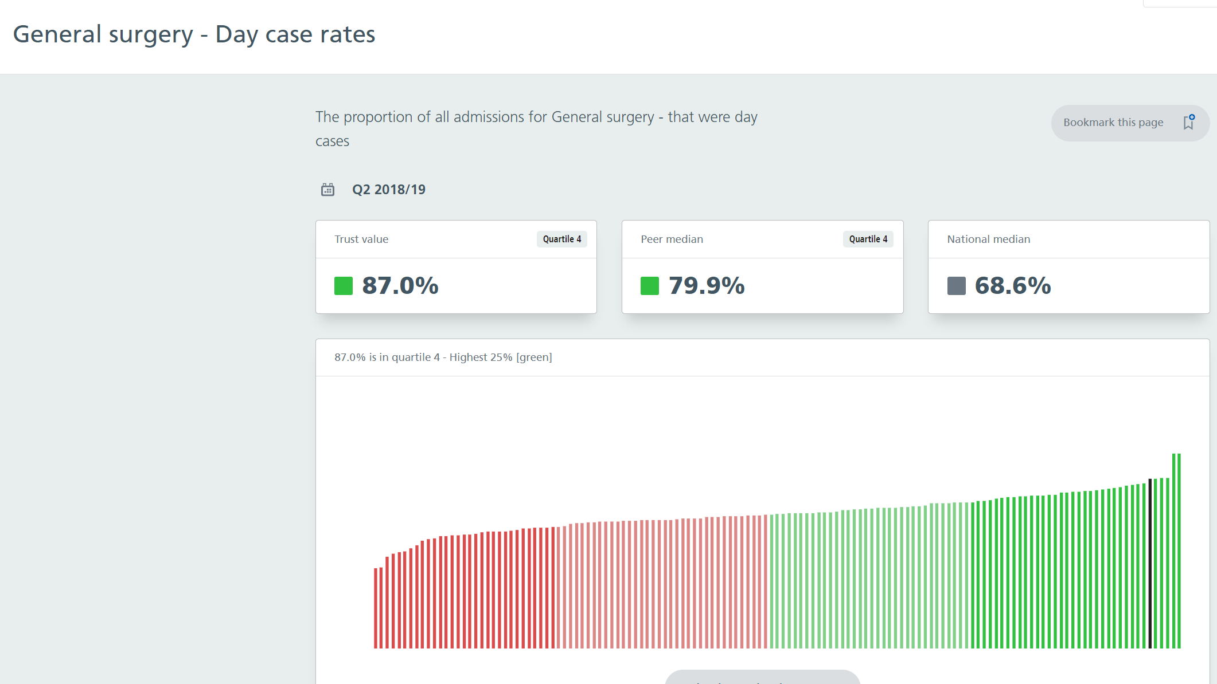

Slide 59
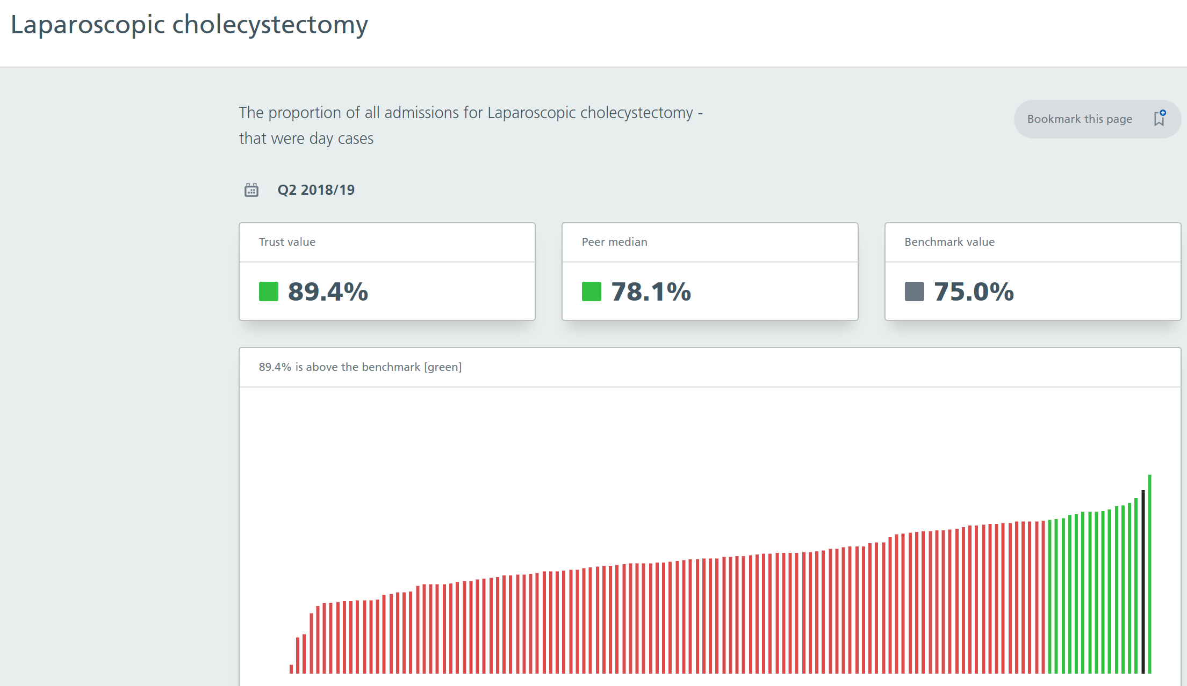

Slide 60
Summary
Hospital reimbursement changed from :
‘Block’ contracts
Payment by Results
Payment by Results with Best Practice Tariff incentivisation
Plus active monitoring and feedback
Incentivisation of Day Surgery has been successful in England

